Slide 1

Empirical Study of Dimensionality Reduction Methodologies for Pose Comparison problems using Computer Vision
Daniel Gerald Orbegoso Barrantes
Notes:
My name is Daniel Gerald Orbegoso Barrantes and I’m a student from the University Oberta de Catalunya, that is pursuing his master tesis at the University from Cambridge. The topic of my research is the Empirical Study of Dimensionality Reduction Methodologies for Pose Comparison problems using Computer Vision. So, let me introduce you to the index of this presentation.

Slide 2
Index
Introduction
State of the Art
Experiment Design
Results
Discussion and Future work
Notes:
In the index we can find the Introduction, the State of the art, The experiment Design, The results and the Discussion and future work. But before going deeper into this research, I would like to read a quote…

Slide 3
“We’re at the beginning of a golden age of AI. Recent advancements have already led to invention that previously lived in the realm of science fiction — and we’ve only scratched the surface of what’s possible”.”
Jeff Bezos, Amazon CEO
Notes:
… from Jeff Bezos that I really like and says We’re at the beginning of a golden age of AI. Recent advancements have already led to invention that previously lived in the realm of science fiction — and we’ve only scratched the surface of what’s possible

Slide 4
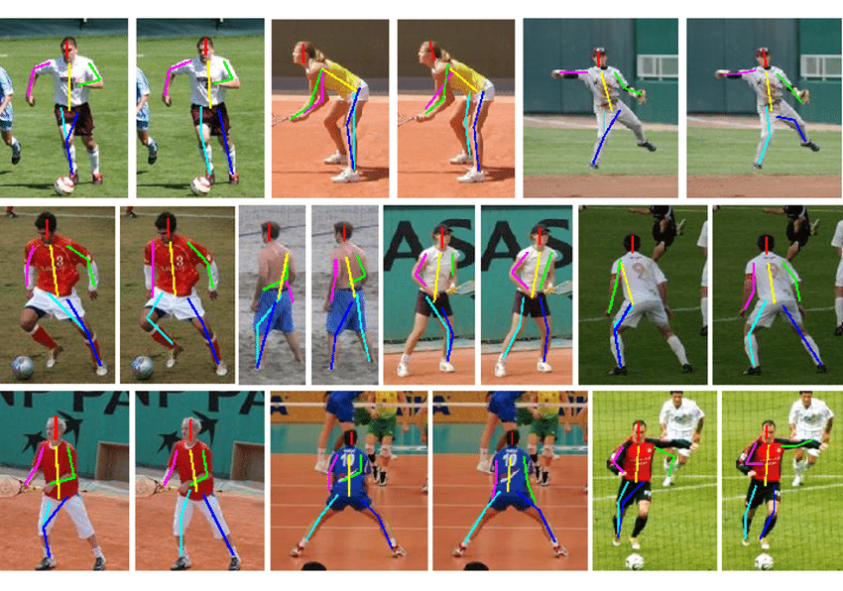
Introduction
This research aims to investigate the definition of pose correctness by applying dimensionality reduction techniques on 3D Skeleton data.
It offers significant advantages: - It enhances computational efficiency. - Improves accuracy and model performance. - Reduce the complexity of high-dimensional data. - Reduce resource requirements, as well reducing the CO2 footprint.
Can we use computer vision to improve movements and techniques in the sports field without relying 100% on a trainer or coach?
Notes:
In this research we aim to understand the definition of pose correctness, by implementing dimensionality reduction algorithms on 3D Skeleton Data, that extract the key dimensions of the data, seeking to improve the accuracy and efficiency of pose estimation models in the field of computer vision.
Advantages:
Enhances computational efficiency, imporving accuracy and model performance.
It reduces the complexity of high-dimensional data, problem in the field of computer vision.
Reduce the resources requirements, which leads to reduce the CO2 footprint.
I always wondered whether computer vision technologies could help sport enthusiasts like me,to improve their techinique without relying 100% on a trainer or coach. And that‘s my personal motivation, for this research, develope a technology that can help and support people.

Slide 5
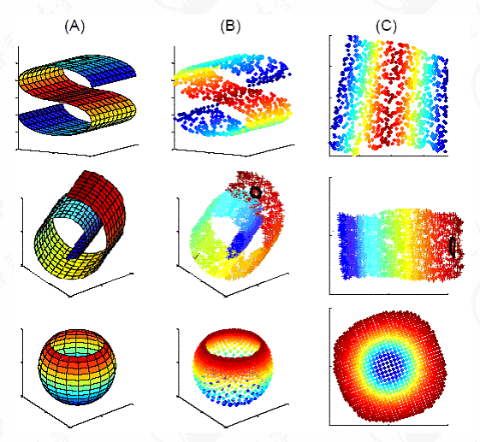

Objectives and Impact
The implementation of dimensionality reduction techniques into comparison problems is the main goal of our investigation.
Reduce the complexity of the data, keep the most important information.
Enable the detection of the key dimension.
Improve the accuracy and efficiency of the existing pose estimation models.
The UOC and this investigation uphold a strong commitment to
Sustainability
Social responsibility
Ethical behaviour
Promotion of human rights and diversity
Notes:
The main objective of the research is the implementation of dimensionality reduction, to understand how can we reduce the complexity of the data, keeping the most important information from the data and detecting the key dimensions that can define the correctness of the movement and improve the accuracy and efficiency of the existing pose estimation models.
I would like to highligth here that this research uphold a strong commitment to sustainability, social responsibility, ethical behavoour and Promotion of human rights and diversity.

Slide 6
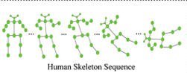
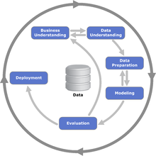
Approach and Methodology
A dataset with 3D Skeleton data for the movement of different subjects is going to be analysed. The goal is to understand the correctness of a specific sport movement, in this case, a squat.
Two base CNN model are going to be used to understand the correctness, using a dataframe with all the dimensions and a second with reduced dimensions.
We are seeking ot answer these questions: Is it possible to implement dimensionality reduction techniques on this type of data? Which parts define better the correctness of the movement?
We are going to use the CRISP-DM methodology.
Notes:
Speaking about the approach and methodology, we are going to use a dataset with 3D Skeleton data, that contains the movement of diffent subjects. The goal is to understand the correctness of a specific sport movement, in this case, the squat. For this purpose, two base CNN models are going to be developed, to understand how well do they perform when are trained with a dataset with all the dimensions and a dataset with reduced dimensions.
We are trying to understand if it is possible to implement dimensionality on this kind of data and in the case it is possible, which parts of the body define better the correctness of this movement.
As a methodology, we are going to use the CRISP-DM methodology, as it is a data mining model used to carry out machine learning projects in the industry.

Slide 7
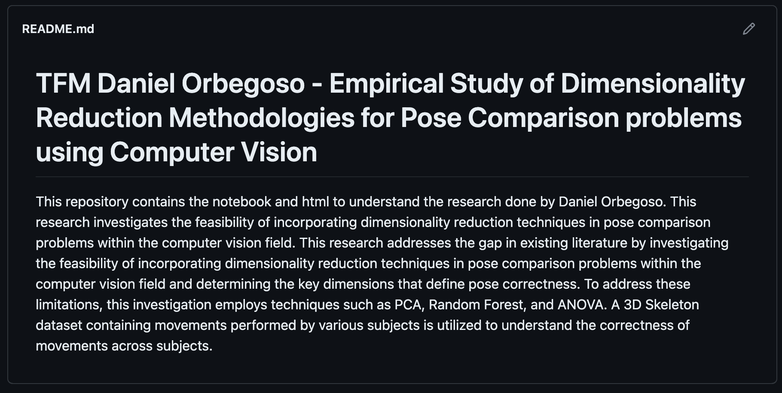
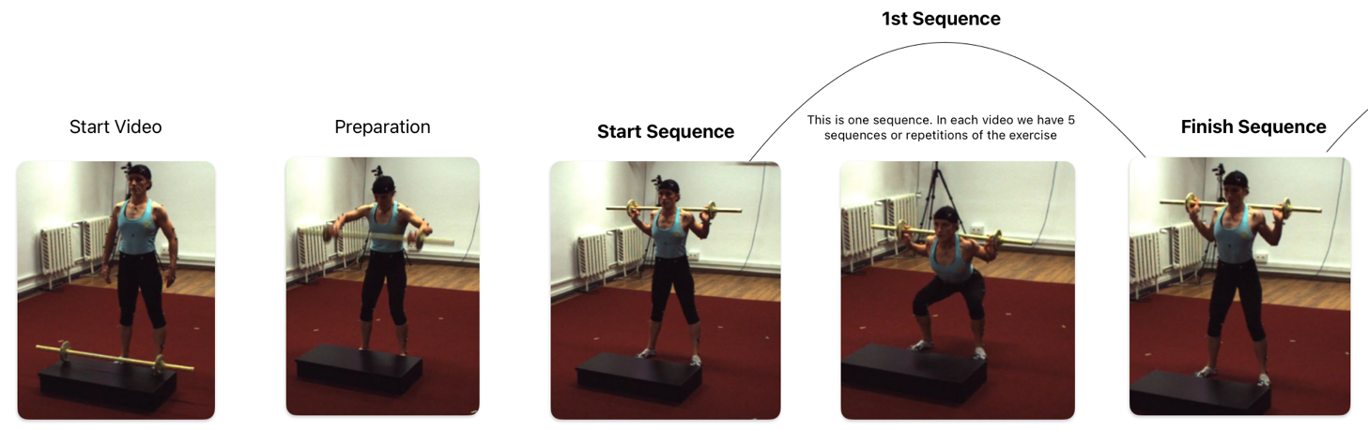
Brief summary of products obtained
Product: Several functions were created in the code, that could be implemented in other projects in the future.
Repository: A repository was created with the code, dissertation and extra documents to facilitate the reader the comprehension of certain sections of this research.
Pipeline: A strategy with the data processing pipeline followed to achieve the desired results was developed and ca be found with this dissertation.
Notes:
Speaking about the products obtained, we have develop several function to prepare and process the data for this research. These fucntions can be reused in other projects and can be found in a repository that was created in github, the link can be fonug in the memory of this research. In this repository we can find as well other documents that can help to understand the pipeline or strategy defined to acheive our goals.

Slide 8

State of the Art
Four areas in the field of computer vison and pose comparison are key to undersand the background of this research
Digital human avatars: virtual representations of the human body.
Biomechanics of the human body: how the various systems and structures of the body, such bones and joints, work together to produce movement?
Correctness of a movement: when we analyse human movement, how do we define a movement or pose as correct or not?
Dimensionality reduction techniques: reduce the dimensions of the data, while retaining the most important information.
Notes:
But before going deeper in the research, we need to understand the background of this research and for that reason I think these 4 topics are key, to understanth this research.
Digital human avatars: digital human avatars helped us to understand better human movement through the creation of virtual representations of the human body. They are usefull tool in the field of computer vision.
Biomechanics of the human body: It is a important area in the study of human movement. It describes the knowledge, that allow us to understand how various systems and structures of the body, such bones and joints, interact betweem them to produce movement.
Correctness of a movement: It is probably the most difficult part to define in this study, as it depends on the background of the research or use case. The correctness can be define in several ways, through the literature of the topic, experiments and articles, or like we described before, biomechanics of the body. For this research we are goin to use the angles crated with the landmarks of the body.
Dimensionality reduction techniques: Dimensionality reduction methods help us to analyse large datasets by reducing their dimensionality, while retaining the most important information.

Slide 9
Experiment design (1)
For this research, two experiments were developed, one for the dataset with all the dimensions and a second for a dataset with the reduced dimensions.
Methodology: The different phases of the methodology CRISP-DM are going to be implemented in this research.
Feature Engineering: it is the process to create features that makes machine algorithms perform better.
Dimensionality Reduction: techniques used to reduce the number of dimensions in a dataset.
Dataset: the dataset used in this research is the Fit3D dataset.
Classification model: A basic one-dimensional convolutional neural network is implemented.
Feature Engineering
Feature
Selection
PCA
LDA
Feature Extraction
Dimensionality reduction
mRMR
Low Variance
Random Forest
Univariate Feature Selection
ExtraTree Classifier
Notes:
So, now we are ready to start witht he experiment design: two use cases are going to be developed in this research, one is the base line use case and a second one is the experimental use case with the dimensional reduced dataset. There are 5 points I would like to highlight in the experiment design
Methodology: The different phases of the methodology CRISP-DM are going to be implemented in this research.
Feature Engineering: it is the process to create features that makes machine algorithms work better and enrich the dataset with necessary dimensions. It will determine the success of our project, without matter the knowledge in statistical or computer techniques.
Dimensionality Reduction: reduce the number of dimensions in a dataset, transforming the original dataset into a lower-dimensional representation while preserving important information.For this research, Random Forest, ANOVA and PCA are going to be used.
Dataset: the dataset used in this research is the Fit3D dataset, generated by fit3D IMAR. It consists of frames capturing the movements of different subjects for different sport movements. Each frame includes the coordinates of a 3D Skeleton with 25 landmarks.
Classification model: For this research, a basic one-dimensional convolutional neural network is implemented. The decision of using a basic model was taken to focus on the feature engineering and dimensionality reduction parts, as they are the focus of these research.

Slide 10
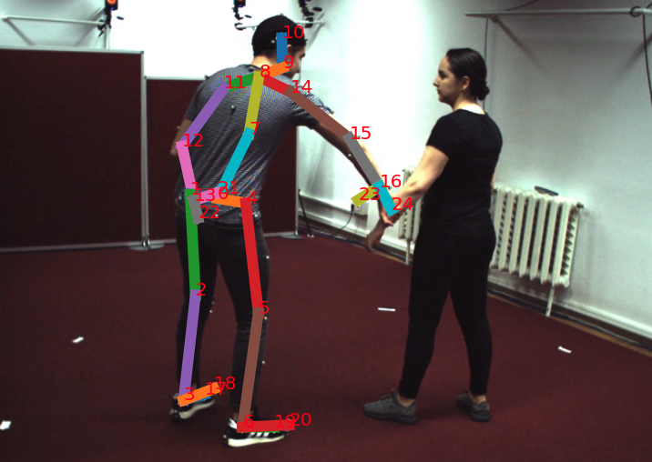
Experiment design (2) – Business Understanding and Data Understanding
In this phase, we tried to understand the business problems needed to be solved and collect the data with the necessary characteristics.
Computing resources needed to develop this research.
Libraries and software needed to develop the code.
Methodology used for this research.
Type of data we need to implement the dimensionality reduction techniques.
Notes:
So lets start with the methodology implemented and we are going to start to explain the Business Understanding and Data Understanding phase.
In this initial phase we try to understand the problems and questions that are necessary to solve and to answer.For example, the computing resources needed to develop this research, in this case, a macbook pro with a M2 chip was used. As Libraries and software we used ML libraries maninly like scypy, numpy, Keras and as a language Python. As a development platform, Jupyter Lab was use. The methodology we thoguht would be useful to implement here was CRISPDM, because of its flexibility. And finally, the type of data we need to imeplement, the dimensionality reduction techinque was selected the Kinematic Data, in concrete we selected 3D Skeleton Data because it is quite flexible and intutitve in terms of working with it.

Slide 11
Experiment design (3) – Data preparation and Modelling
This phase seeks to prepare the data to be used by the machine learning algorithms.
A dataset is created and pre-processed from the original raw data with 76 dimensions.
Feature engineering techniques are implemented, obtaining 105 dimensions.
Angle calculation
Error calculation
Sequence alignment
Creation of synthetic data (imbalanced dataset)
Feature selection techniques like Random Forest and ANOVA implemented. The landmark angles are selected, with a total of 15 dimensions.
Feature extraction techniques as PCA were implemented, 3 new synthetic dimensions are added to the reduced dataset.
Two different use cases are developed: Baseline use case and experimental use case
The results are measured in terms of:
Training and validation accuracy and loss.
Matrix confusion
Training time
CO2 footprint.
Notes:
The Data preparation and Modelling phase seeks to prepare the data to be used by the machine learning algorithms. Once the data is prepared, it can be used with the machine learning model.
For this research, a dataset is created and pre-processed from the original raw data, obtaining a dataset with 76 dimensions, counting with landmarks and subjects identifiers.
With this new dataframe we are going to implemente Feature engineering techniques, to enrich the dataset, obtaining a total of 105 dimensions. This part is crucial and several functions were created to
Calculate the angles between landmarks of the body
Align the different sequences of the movements in the videos to be able to calculate the errors of the different frames, comparing the trainees with the trainers, that describes the correctness of the movement.
Creation of synthetic data (imbalanced dataset)
Wit the enriched data, we implemented feature selection techniques like Random Forest and ANOVA, and the results shows use that the landmark angles were crucial when understanding the correctness, therefore they were selected to create the reduced dataset, with a total of 15 dimensions.
From this reduced dataset, a feature extraction technique like PCA was implemented over the reduced dataset to create 3 new synthetic dimensions, that will be added to the reduced dataset.
With the data prepared, two use cases are going to be created in this research.One for a base CNN model trained with the full dataset, and a second use case with a CNN model trained with the reduced dataset.
The results were measured in terms of training and validation accuracy and loss, matrix confusion, training time and CO2 footprint.

Slide 12
Results(1)
Metrics | Baselines Use case – No dimensionality reduction. CNN model trained for 200 epochs | Experimental Use Case – Dimensionality reduction applied. CNN model trained for 200 epochs
Training accuracy | 0.88 after 100 epochs | 0.92 after 25 epochs
Trainig loss | 0.20 after almost 200 epochs | 0.20 after 50 epochs
Validation accuracy | 0.90 after 100 epochs | 0.95 after 25 epochs
Validation loss | 0.16 after 200 epochs | 0.10 after 100 epochs
Training time | 7.83 seconds – 100 dims | 4.90 seconds -18 dims
Accuracy test | 0.932 | 0.953
Matrix confusion | good results, but lacks precision with the correct label | better results, but still lacks a bit precision with the correct label
CO2 footprint | 2.81e-05 CO2 | 1.85e-05 CO2
The results obtained allowed us to understand that angles formed between the upper landmarks of the human body are key, when trying to understand the correctness of the squat.
Notes:
As we can appreciate the results for the training accuracy are improved in the experimental use case, in compare with the baseline use case We have the same results for the loss, where we were able to reach faster smaller loss in compare with the baseline use case. Speaking about the validation data, we have as well improved with less dimensions the accuracy, and reach much faster higher accuracy and loss with less number of dimensions. The training time is reduced as well with the reduced dataset, cutting almost 3 seconds and as you can see the accuracy test was improved. Speaking about the matrix confusion, the results even lacking a bit of precission for the correct label are good and again improved with a reduced dimension. The footprint decreased also, by 1 point. The results in general are pretty good and we were able to implement the algorithms successfully in this kind of data, allowing us to understand which part of the body or which angle and landmarks are importantly, to find the correctness of the squad.

Slide 13
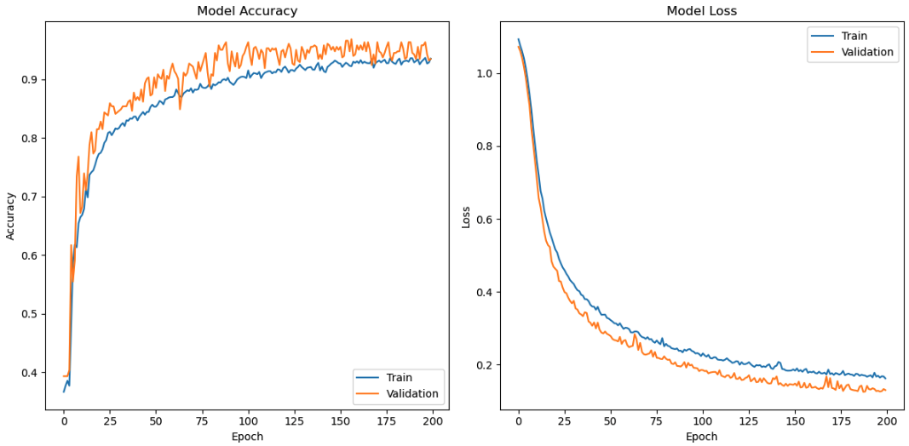
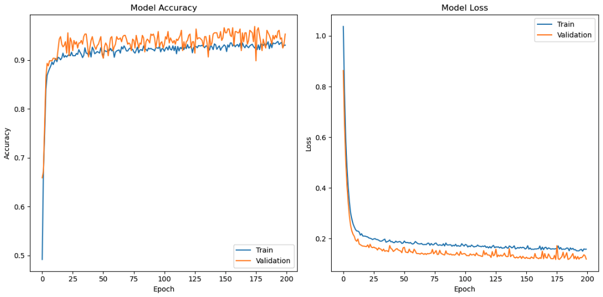
Results(2)
Baselines Use case – No dimensionality reduction
Experimental Use Case – Dimensionality reduction applied
Notes:
n the graphics, we can appreciate a bit of noise and underfitting, this is a problem related to the models that we have implemented and as well, because of the scarce of data. This problem could be solved in the future with more complex models, but this part was not in the scope of this research.

Slide 14
Discussion and future work
This research highlights the significant impact of dimensionality reduction algorithms, such as Random Forest and PCA, on 3D Skeleton Data Analysis.
Dimensionality reduction algorithms can be used on 3D Skeleton Data
Training time reduced by 38%.
Accuracy of the model improved by 5%.
Dimensional space reduced by 80%.
CO2 footprint reduced by 35%.
Identified the key dimensions in the dataset that enable accurate pose comparison.
Importance of selecting the proper methodology.
Understood the complexity of working with 3D Skeleton data and developed a strategy to work with this type of data.
Reduce the use of computational resources.
Future work
Data preparation: improvement of the strategy used to enrich the data. Loss of valuable information.
Dimensionality reduction algorithms: Other dimensionality reduction algorithms like Kendall, LDA or t-SNE could be implemented.
Models: In this research a basic CNN model was used. More complex models like LSTM or transformers can be implemented.
Notes:
This research highlights the significant impact of dimensionality reduction algorithms on 3D Skeleton data. We were able to prove the use of this algorithms on 3-D skeleton, achieving tremendous advantages, like reducing by 38% the training time of the CNN model, improving by a 5% the accuracy. Reducing by 80% the dimensional space of the data, and the CO2 footprint by 35%. We have identified the key dimensions that enable accurate pose comparison and we have understood the importance of selecting the proper methodology to process our data. As well we understood how complex it is to work with 3D Skeleton data and develop a strategy to work with this type of data, finally reducing the use of competition resources that is a hot topic on the airfield.
The future work opens a lot of possibilities and space for development.
Data preparation: by the improvement of the strategy used to enrich the data, we can improve the quality of the data and reduce the loss of valuable information.
Dimensionality reduction algorithms: Other algorithms for future selection like Kendall or for feature extraction like LDA or t-SNE could be implemented, to make a benchmark between them and improve the results already obtained.
Models: In this research a basic CNN model was used. But this model can be improved with model tunning and other models could be used, the ones are more complex and understand better the spatial and temporal relationships between the points in the 3D space like LSTM or transformers.

Slide 15
Conclusion
Dimensionality reduction techniques are a powerful tool, that can leverage the potential inside of 3D Skeleton data for computer vision problems. We have obtained pretty good results, but as well we have discovered the huge challenge when working with this type of data. The research also highlighted the importance of understanding biomechanics, particularly in the context of computer vision and sports.
Through this research, we have successfully reduced resource consumption and mitigated the negative environmental impact associated with AI technologies, particularly in terms of CO2 emissions. The implementation of these technologies not only benefits the environment but also has a positive social impact by improving systems that support health quality of humans.
I hope future students and researchers can use this code and that the research helps them providing a solid framework to build upon. There is ample room to advance the field!
Notes:
Dimensionality reduction techniques are a powerful tool, that can leverage the whole potential in our, in computer vision problems. We were able to verify the advantages using these techinques, but as well the completxities working with this kind of data. Throuhg this research we have succesfully achieve the goals we have defined at the beginning, but not only that, as well we have discovered the enviromental benefits and positive social impact in the health quality of humnas in the future.
I hope future students and researchers can use and expand the code use in this investigation.

Slide 16
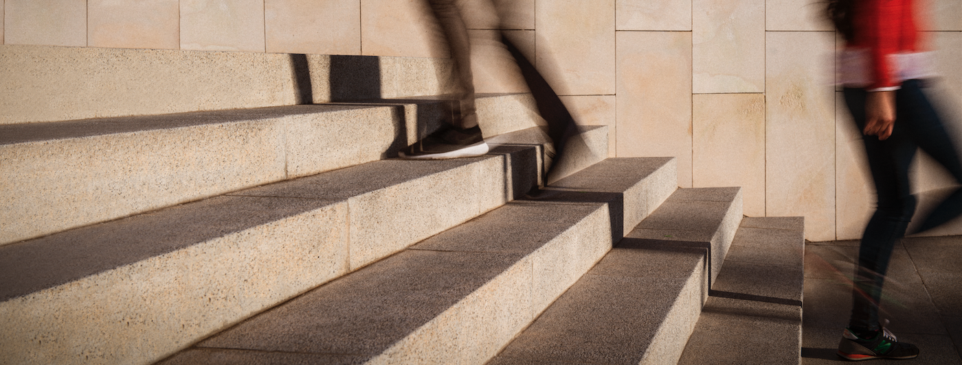
Thank you for your time!
“Noise is the main distraction
between you and
your goals"
Notes:
Thank you so much for your time, and I would like to finish with a quote I have created on my own and is the next one: Noise, is the main distraction between you and your goals.

Slide 17



facebook
@twitter
instagram

